Slide 1
What are the 7 steps of index testing?
Step 1. Introduce Index Testing Services to the Index Client during pre-test session or PMTCT/ART visit
Step 2. Obtain a list of sex partners and biological children < 15 with unknown HIV status
Step 3. Conduct an intimate partner violence (IPV) risk assessment for each named partner
Step 4. Determine the preferred method of partner notification or child testing for each named partner/child
Step 5. Contact all named partners and biological children <15 with unknown status using preferred approach
Step 6. Record outcomes of partner notification and family testing
Step 7. Provide appropriate services for children and partner(s) based on HIV status

Slide 2
Detailed Steps for Index Testing Services
Step 1: Introduce Index Testing Services to the Index Client during pre-test session or PMTCT/ART visit
Use Index Testing Talking Points to introduce partner/family testing to the index client and complete
Index Testing Register/Forms
Step 2: Obtain a list of sex and needle-sharing partners and biological children < 15 with unknown HIV status
Use the Index Testing Register/Forms to record partner(s)’/child(ren)’s names and contact information
Step 3: Screen all named partners for intimate partner violence (IPV)
Use the Index Testing Register/Forms to document results of IPV screening and preferred partner notification and/or child testing method.
Complete one form for each named partner
Exclude partners posing a high risk of IPV; refer index client to IPV/OVC services where available and discuss other options for disclosure
Step 4: Determine the preferred method of partner notification or child testing for each named partner/child and record on Index Testing Register/Forms
Dual Referral: Coach client on joint disclosure or allow client to test with partner as if their HIV status is unknown; make plans for when and where joint disclosure will occur; offer HIV testing to partner
Mutual Agreement Referral: Provide referral letter and disclosure script; agree that client will refer partner or bring the child for HIV testing services within 7 days
Provider Referral: Initiate partner contact attempts* using the example script
Community Based: Confirm a day/time the provider will test the partner/child(ren) in the home*
Client Referral: Coach client on disclosure; provide “Tips for Telling Your Partner about HIV” and referral letter
Facility Based: Confirm an appointment to test biological children <15
Step 5: Trace/visit all named partners and test all biological children <15 with unknown status using the preferred approach
Step 6: Record partner notification and family testing outcomes on the Index Testing Register/Forms
Was partner successfully contacted?
Was the child tested?
Yes
No
Step 7: Provide appropriate services for children based on HIV status, seroconcordant/discordant partners, or work to support disclosure
Record successful partner contact or child test (including HIV status) on Index Testing Register/Forms
If Mutual Agreement Referral, initiate provider referral for partners or home testing for children after 7 days; otherwise record unsuccessful contact on Index Testing Register/Forms
*Note: Direct partner notification (telling sexual partners they have been exposed to HIV) is not recommended by the National Department of Health due to high rates of intimate partner violence in South Africa

Slide 3


Seven Tips for Partner Elicitation
Introduce partner notification in pre-test counseling session
Use appropriate questions/ language to ask about partner(s) and children
Assure clients of the confidentiality of services: partners will be traced and be offered testing for the ‘Cheka Impilo’ National Wellness Campaign
There is no need for client to disclose their HIV status, partners will be traced and offered a test anonymously.
Use humor and slang to probe for additional partners and make clients feel comfortable with you
Use brief motivational interviewing to create rapport with clients
Act natural and do not make the elicitation weird, judgmental, or stressful for the client

Slide 4
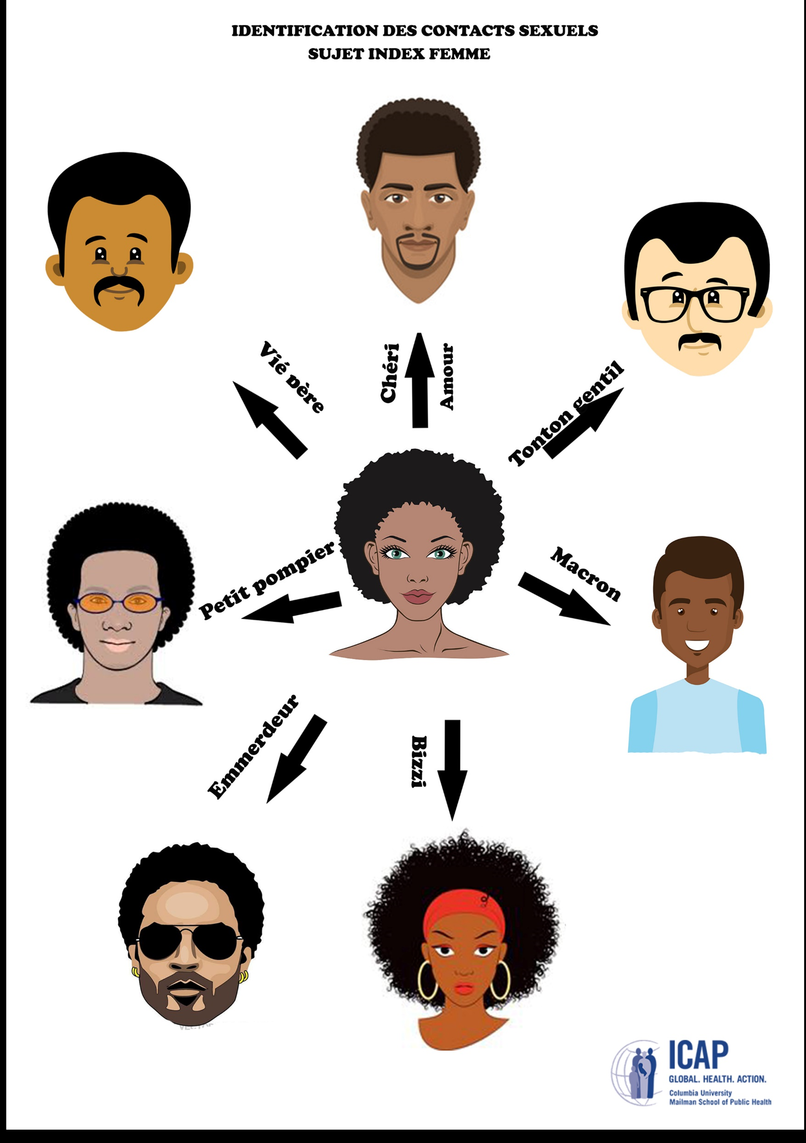
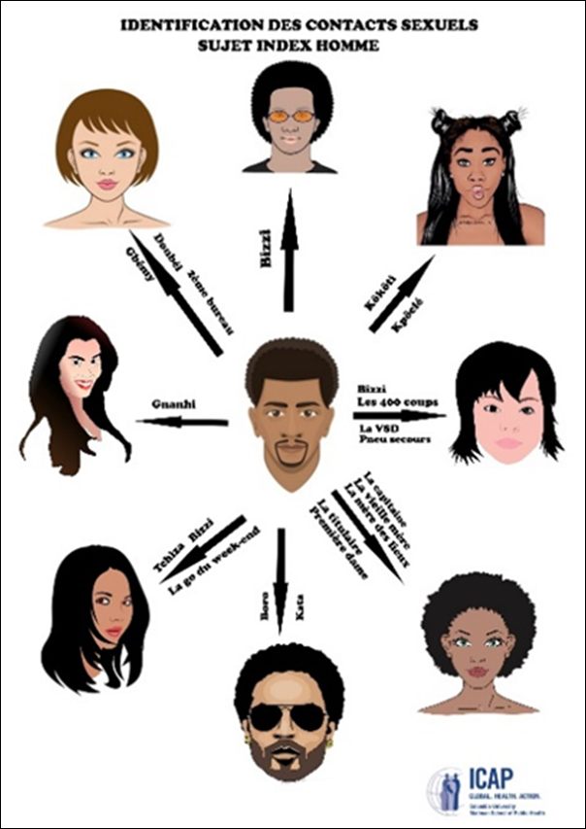
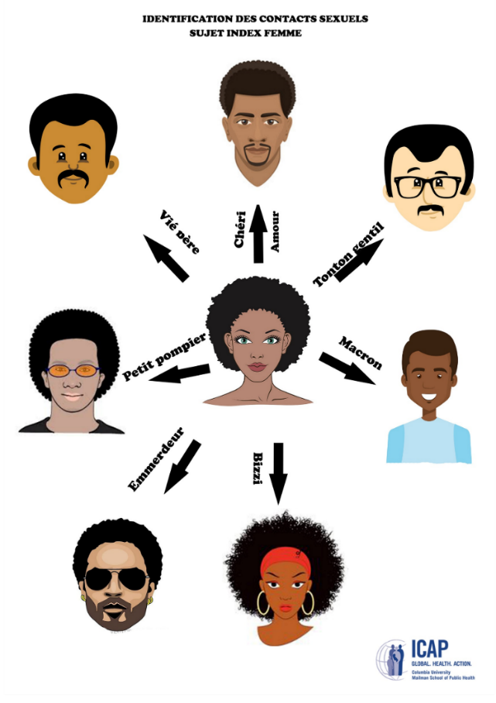

Tip 5 for Partner Elicitation: Use Humor and Appropriate Slang to Probe and Make the Client Feel Comfortable
After client responds about ‘main partner,’ probe for additional partners using slang terms that are common in the community
Ask expert clients, including AGYW, to give you popular terms used in the community

Slide 5


Tip 5: Popular Slang Terms used by men
iKati
Ikhwapha/umakhwapheni
Sugar Baby
Ohlekisana naye (older men)
Ume ngomlenze owodwa ngempela? (Probing )
i-Vrou
uMuntu wakho
Oncokola Naye
Moghel
Wifey
Bae
Baby mamma
Stokko
Nyatsi
Side dish/ side kick/ side chick
oMamncane
oSisterz
Medi
iThekeni
Cherrie
uMadam
oMaBhebeza

Slide 6

Tip 5: Possible Slang Terms used by women
Daddy
Brotherz
Mjita
Bae
Boo
Valentine
Sweety/Soulmate/Better Half
Umngani wesilisisa (Appropriate for older women)
Ishende
Minister of Finance/ Housing/Transport
Minister of wobumnandi
Sugar Daddy
U-Baba
uMuntu wakho
uMy person (Mperson)
Isidikiselo
Ikhwapha/makhwapheni
Mr Fun

Slide 7

Tip 6 for Partner Elicitation: Use Brief Motivational Interviewing as a Strategy for Partner Elicitation
Open-ended Questions
(‘Tell me about’…or ‘what else?’)
Affirming Statements
(‘I appreciate that it took a lot of courage for you to discuss your sexual partners with me today’)
Reflective Listening
(‘If I hear you correctly you are saying’…..or ‘it sounds like you feel afraid because of…..’)
Summarize the Conversation
(‘Today we discussed a, b, c, and we are agreed on a, b, c and our next steps are 1, 2, 3’)

Slide 8
Tips for Telling Your Partner about HIV Testing
Make a Plan:
Many people are afraid of telling their partner that they have HIV. It is helpful to make a plan for how and when you will tell your partner.
Think about how you would like to be told, if your partner was disclosing to you.
Choose a day and a time when you and your partner will have time to talk.
You also want to pick a time when your partner is not stressed or angry, and has not been drinking alcohol.
Pick a private place where you feel comfortable and safe. You may want to have someone in the next room to help and support you, if needed.
Anticipate Reactions:
Think about how your partner may react. Your partner may:
Offer you support or comfort you
Not believe it’s true
Feel confused or sad
Feel angry
Accuse you of bringing HIV into the relationship or household
Think about how you will respond to these reactions.
What questions may your partner ask you? How will you answer these questions?
Start the Conversation:
“I went to the clinic the other day (or for xyz reason) and the nurse was encouraging people to get tested for HIV. So I got tested and learned that I have HIV. I wanted you to know so that you could also get an HIV test. There are medicine now for treating HIV that can help us live a long time.”
“HIV is very common in our community. I decided to go for an HIV test. It turns out that I am HIV-positive. I already started on treatment. I think it is important that you also get tested so you can know your HIV status.”
Encourage Your Partner to Get Tested for HIV:
Give your partner the referral slip
Tell your partner that it is important they get tested for HIV. If they are HIV-positive, they can get medicines to treat their HIV. These medicines can save their life and reduce the chance they will pass HIV onto others.
If they are HIV-negative, there are things they can do to help them remain negative like use condoms, take pre-exposure prophylaxis (PrEP), or get circumcised (if they are male).
Offer support because this is difficult news for someone to hear. “We can work on this together. I will support you.”
Practice First!
Practice what you will say and do ahead of time. You can do that now with your health care provider or later by yourself in your home. This will help you feel comfortable on the day you actually tell your partner.

Slide 9
Script for Provider Referral
Telephone call script:
Counsellor: Hi, you are speaking to Zama Mkhize from Waterfall Clinic. The reason I’m calling you is because the Department of Health would like to invite you to come to the clinic for health screening.* We will do your blood pressure, diabetes, weight and other health screenings to ensure you remain healthy. When you arrive please ask to see Zama the counselor. Or would you prefer we come to your home to offer the services there?
Client: Where did you get my cell number?
Counsellor: We are phoning everyone in the ward that you live in. The department has the information for all ward residents….
Home visits:
During home visits, teams should also offer testing services to 3-4 houses around the index contact’s home to mitigate stigma!
*’Cheka Impilo’ National Wellness Campaign: http://www.health.gov.za/index.php/gf-tb-program/427-cheka-impilo-campaign

